Slide 1
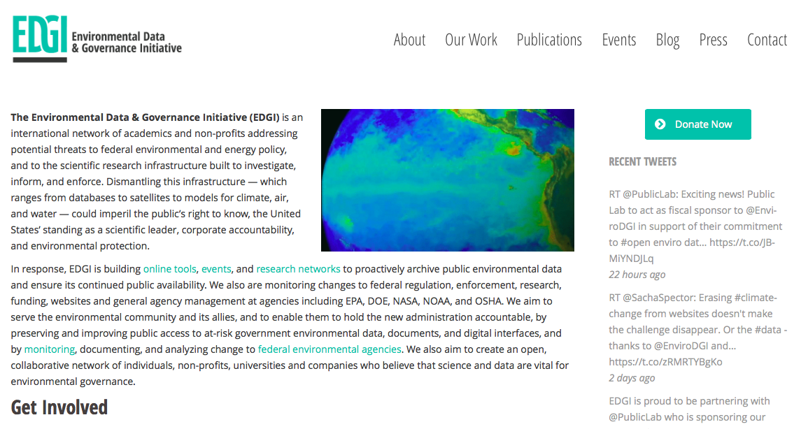
Environmental Data Activism under the Trump Administration
Lindsey Dillon
UCSC Sociology
Environmental Data and Governance Initiative (EDGI)
With special thanks to Toly Rinberg and Maya Anjur-Dietrich (Harvard), Matt Price and Dawn Walker (U Toronto), and all of EDGI!

Slide 2
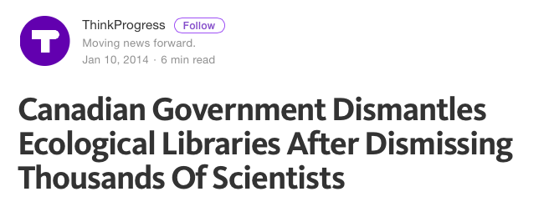
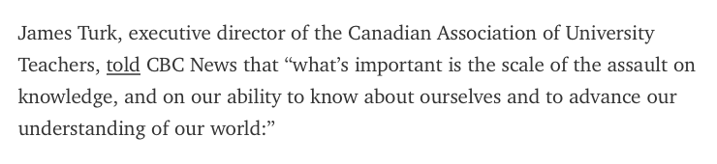
Notes:
https://thinkprogress.org/canadian-government-dismantles-ecological-libraries-after-dismissing-thousands-of-scientists-d466cb9e79f4

Slide 3
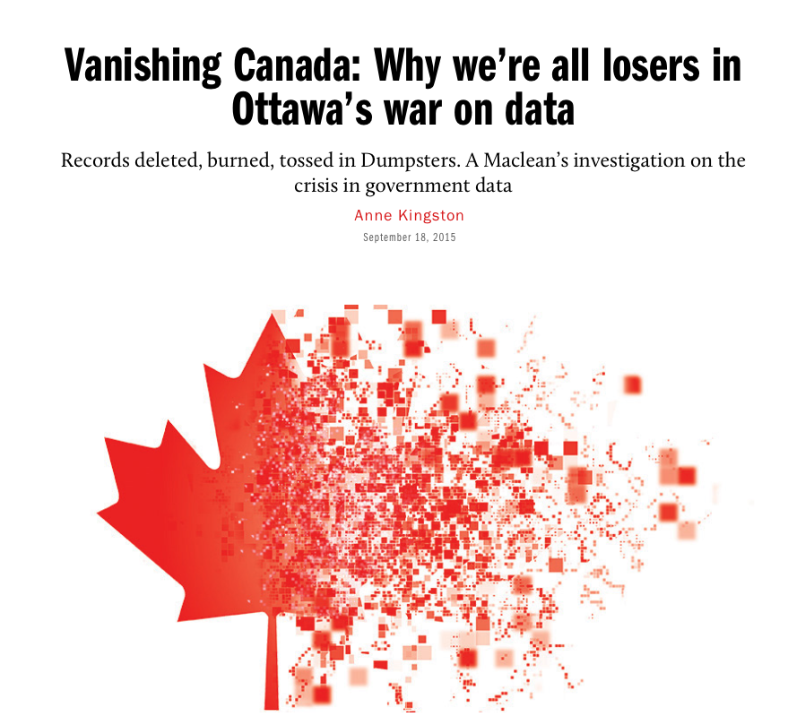
Notes:
http://www.macleans.ca/news/canada/vanishing-canada-why-were-all-losers-in-ottawas-war-on-data/

Slide 4
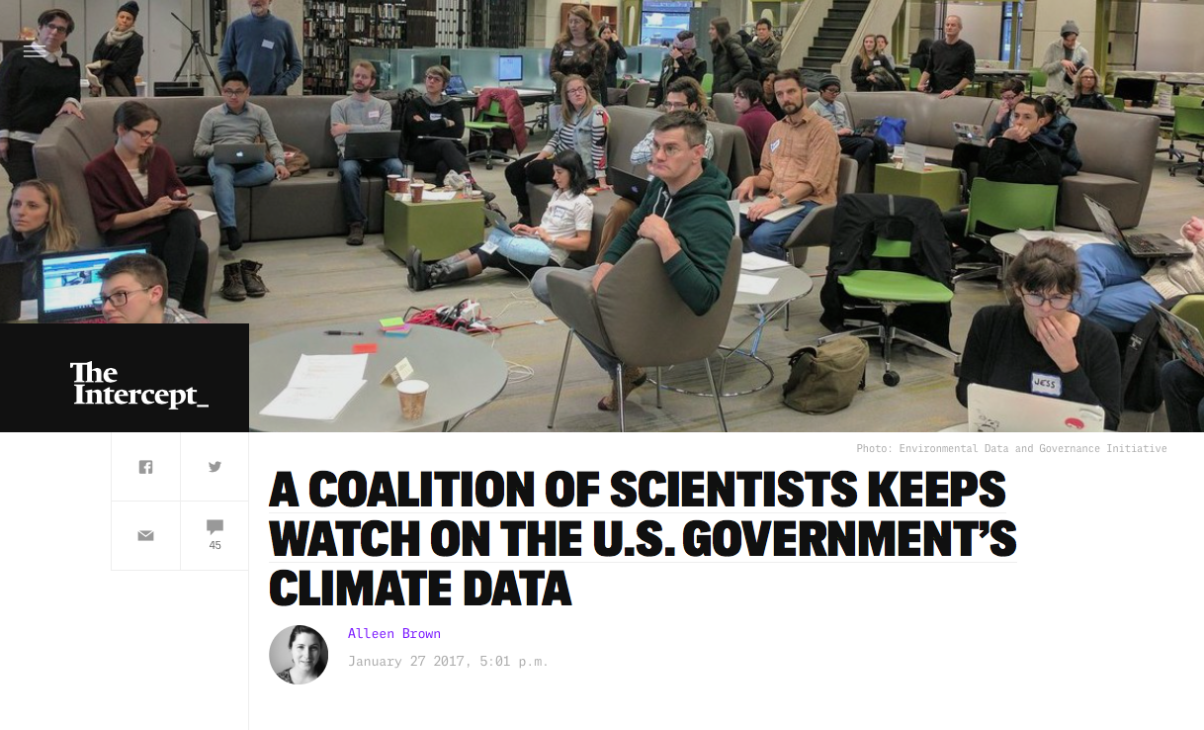
Notes:
For lindsey!

Slide 5
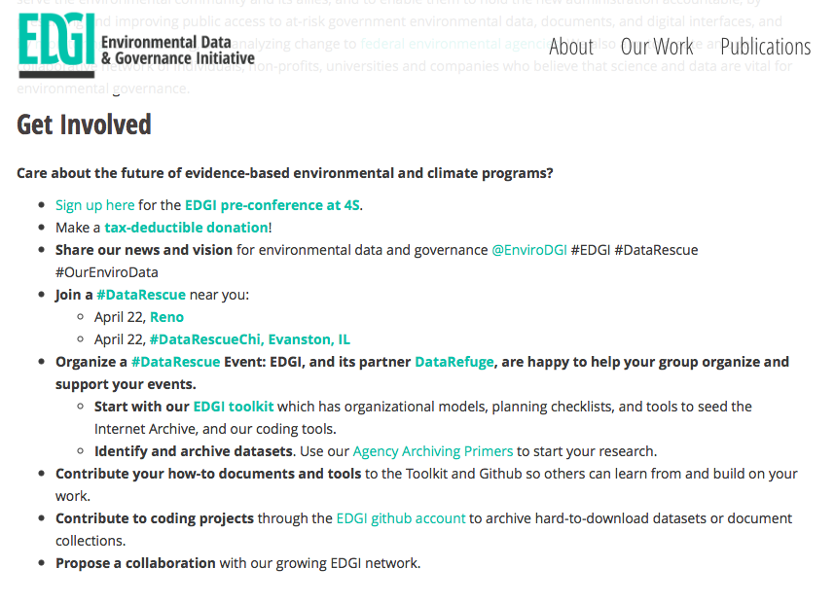


Slide 6
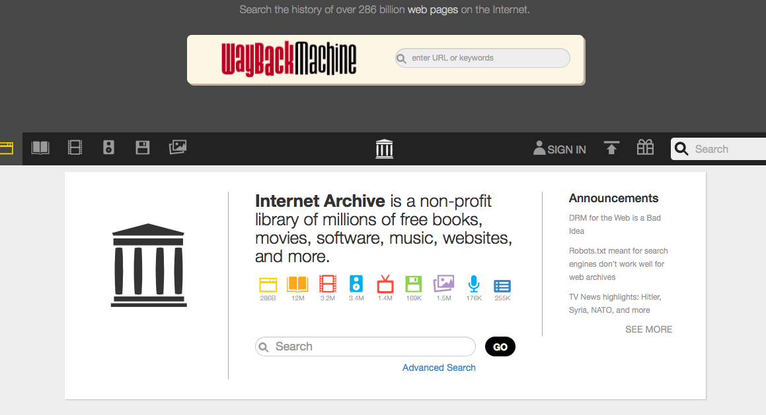

Slide 7
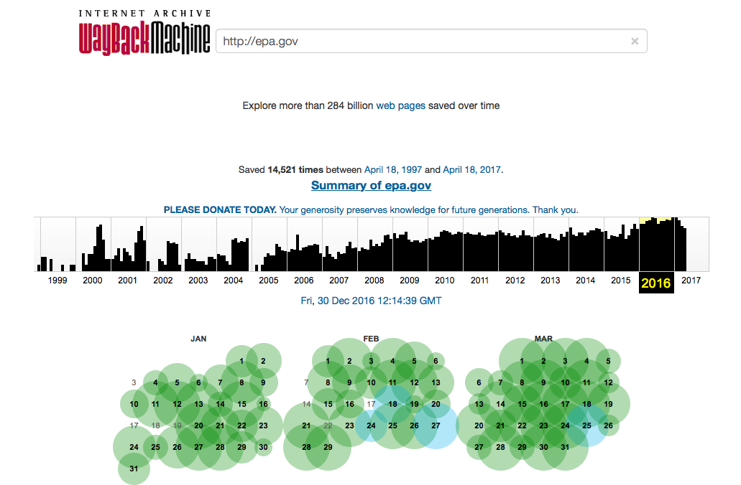

Slide 8

Notes:
Epa.gov screen shot from April 19, 2017

Slide 9
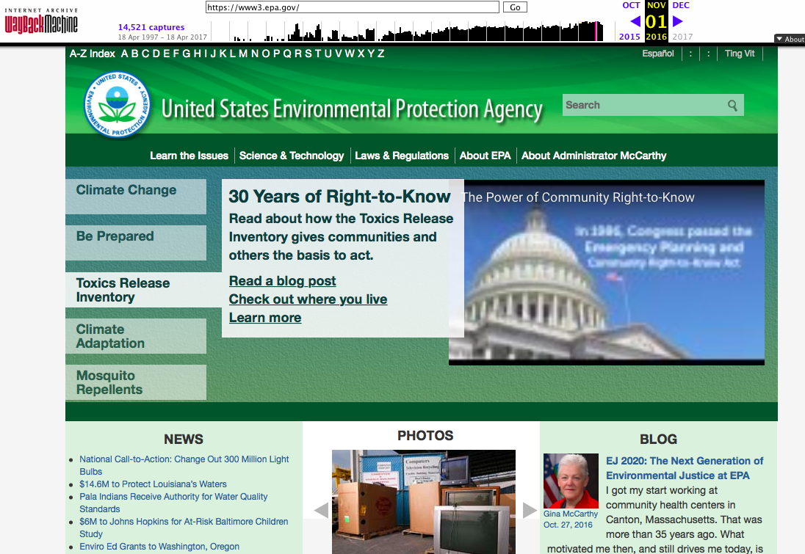
Notes:
Wayback capture from November 1, 2016

Slide 10
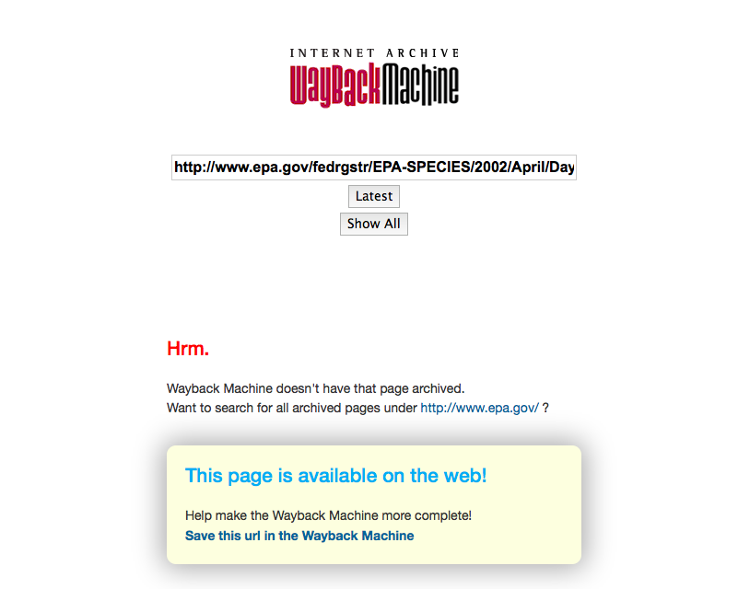
Notes:
When the IA doesn’t have a page - but you can nominate the URL to be crawled!

Slide 11
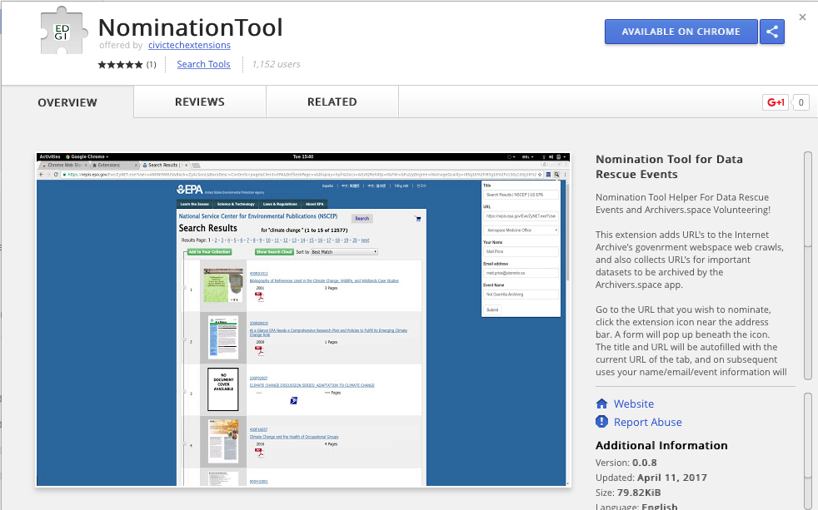
Notes:
Chrome Nomination Tool

Slide 12
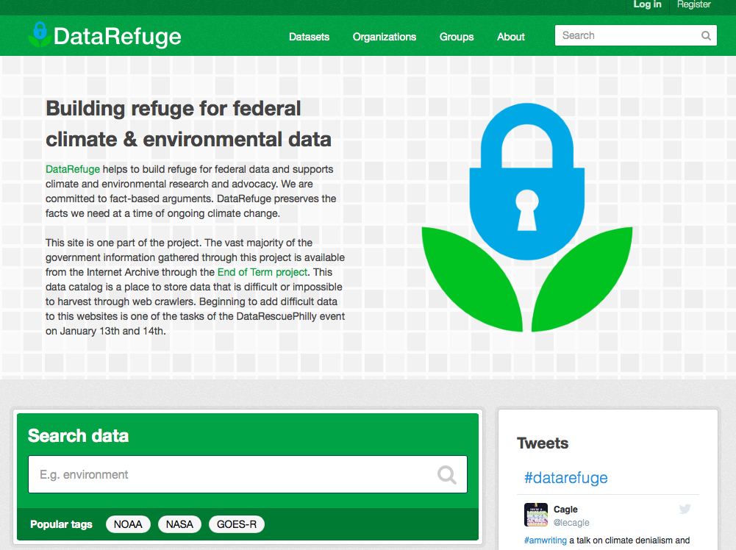

Slide 13
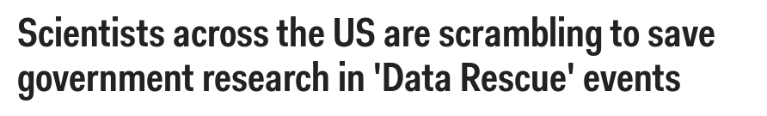

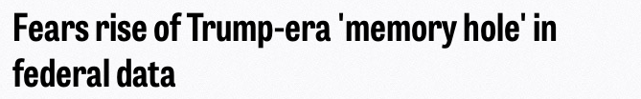
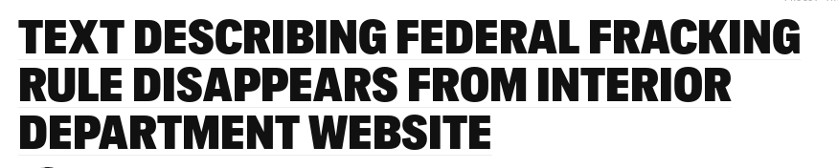

Slide 14

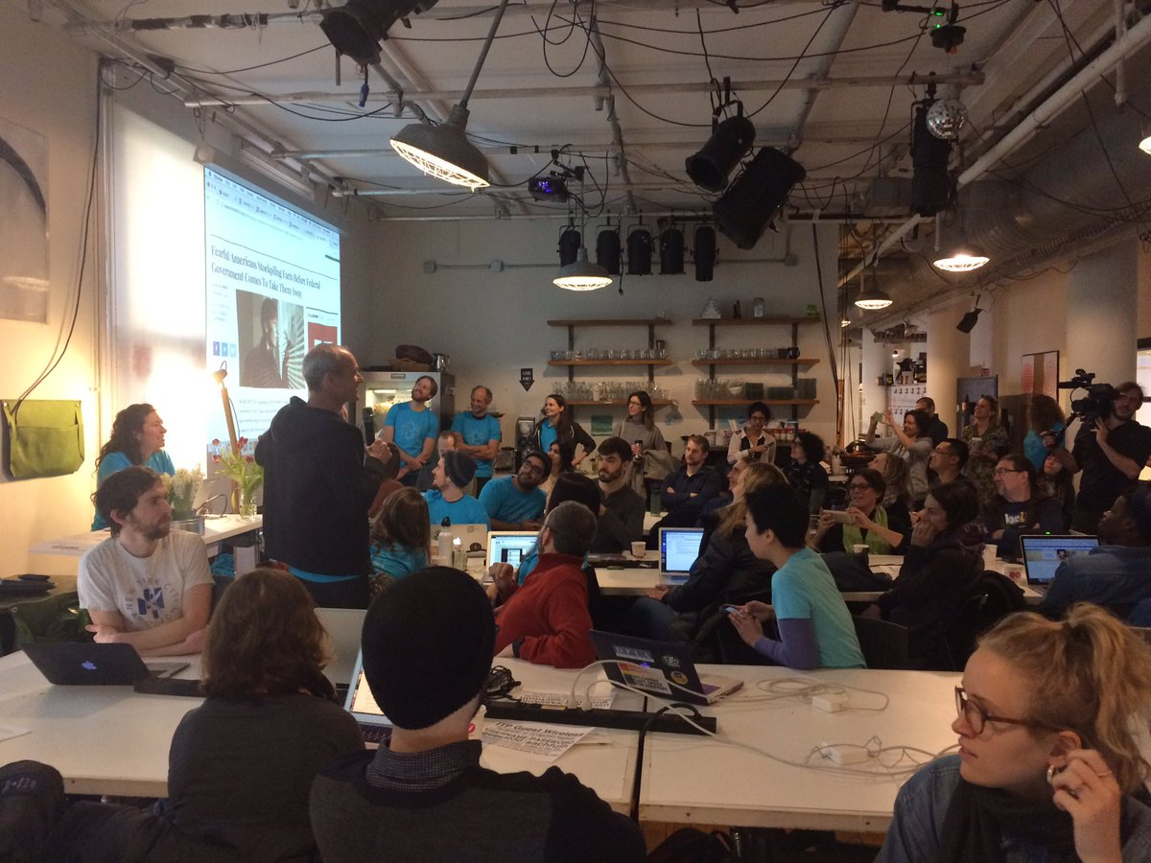
Data Rescue NYC

Slide 15
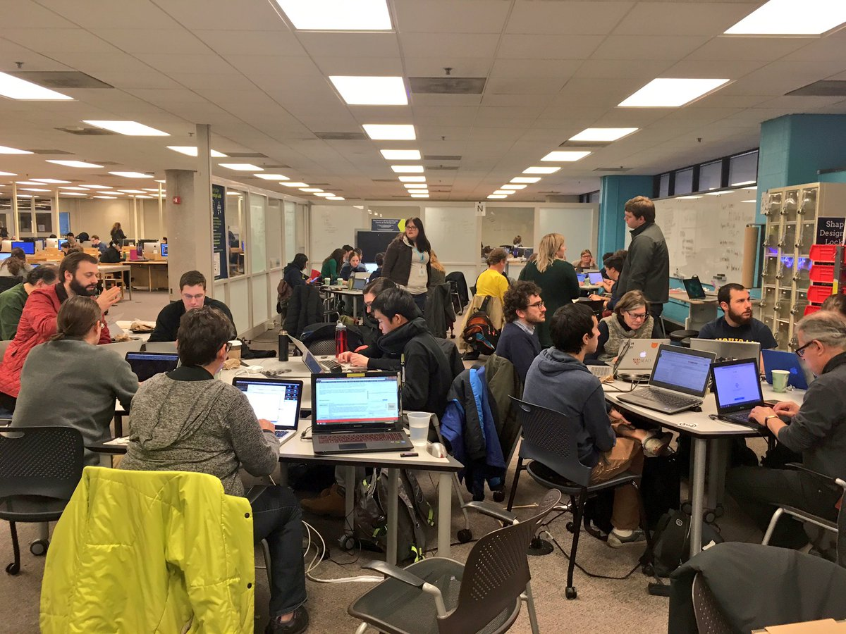
Data Rescue
Ann Arbor

Slide 16
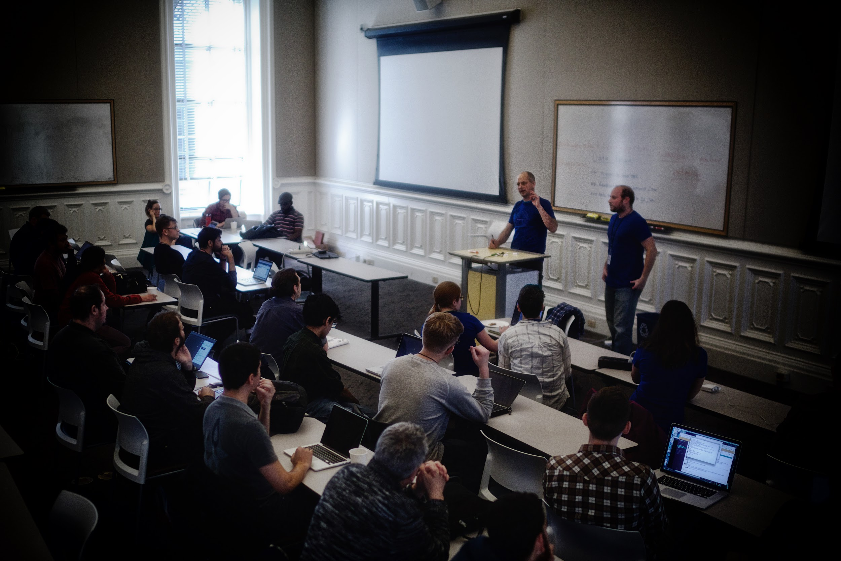

Data Rescue
SF Bay Area
Notes:
The interest in hosting the events, in cities across the country also speaks to not just the timeliness of the work but the value of scientific data as a common resource. We are not for ALL open data rather we promote scientific data as a public or common resource, rather than national property. Scientific data should not be vulnerable to any administration (not just about Trump).

Slide 17
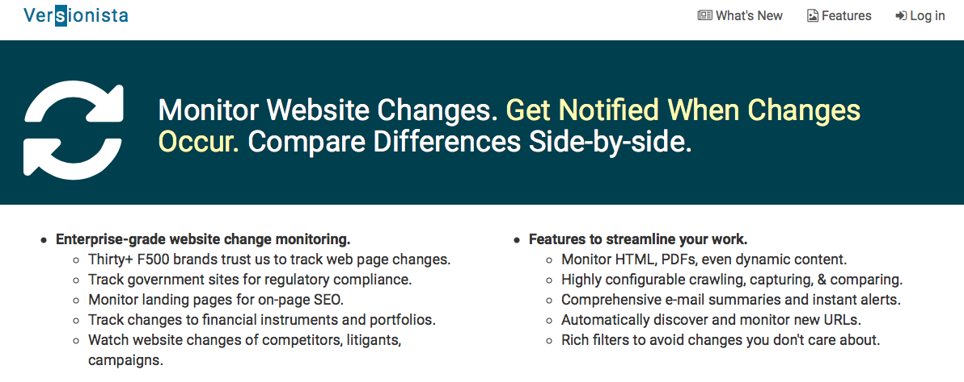


Slide 18
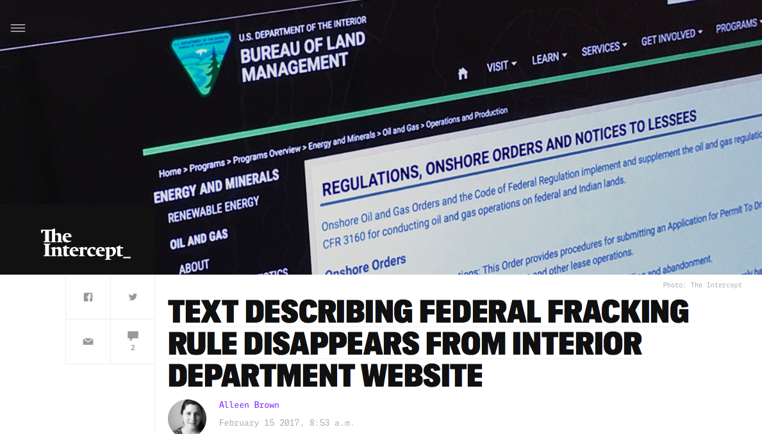

Slide 19

Notes:
April 5, 2017

Slide 20
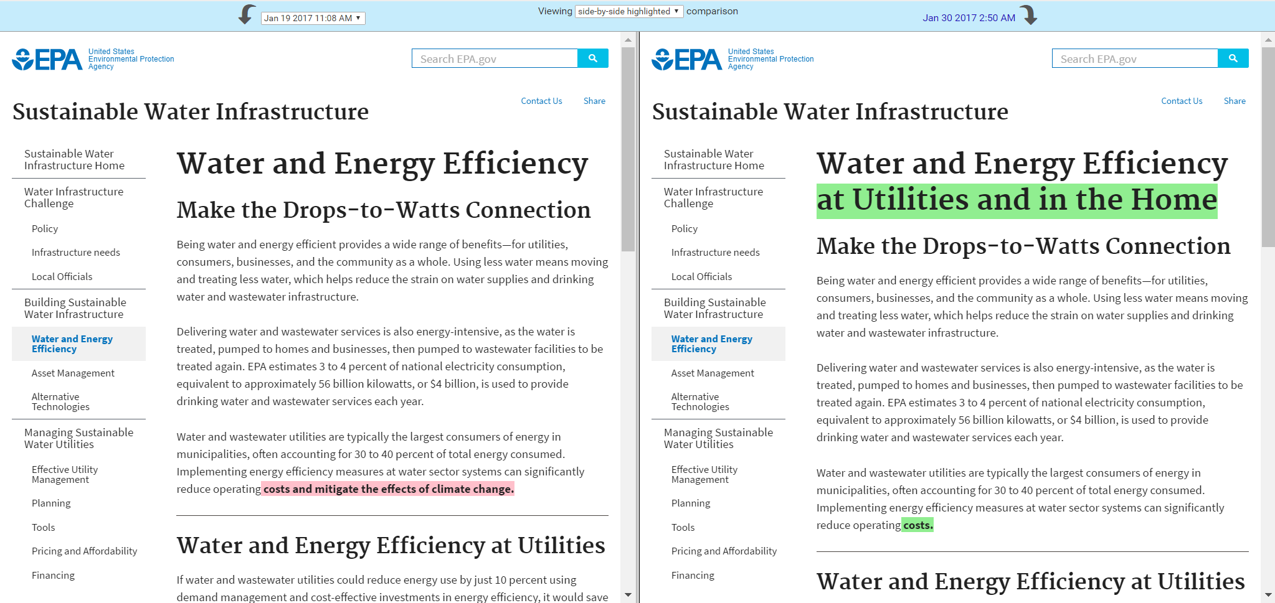
https://www.epa.gov/sustainable-water-infrastructure/water-and-energy-efficiency-utilities-and-home
January 19 - 11:08am
January 30 – 2:50am

Slide 21

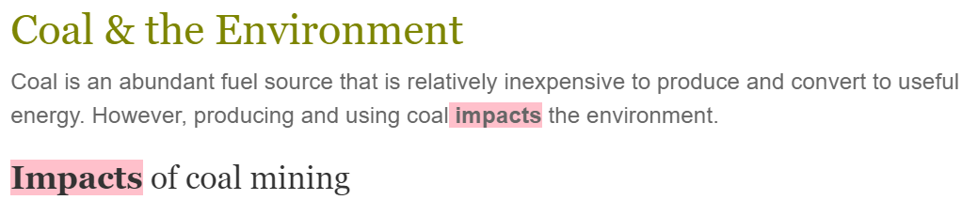
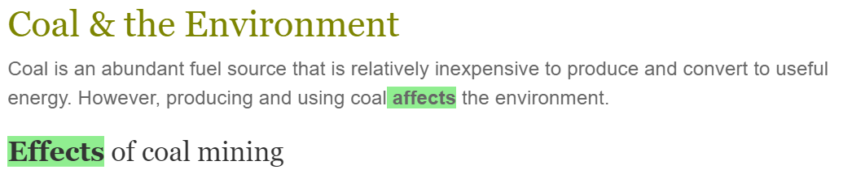

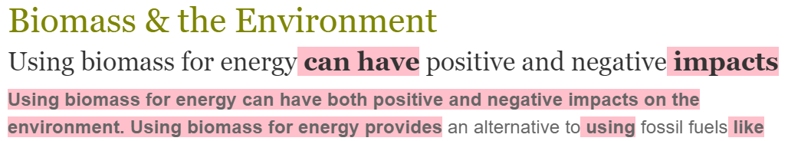
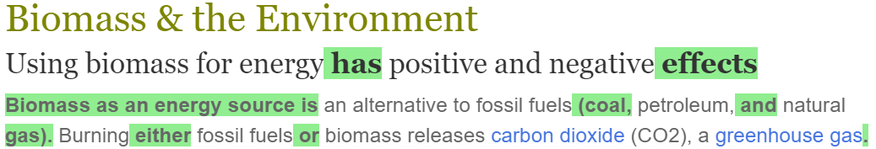



http://www.eia.gov/kids/ . . . /
Jan 17
Feb 8

Slide 22
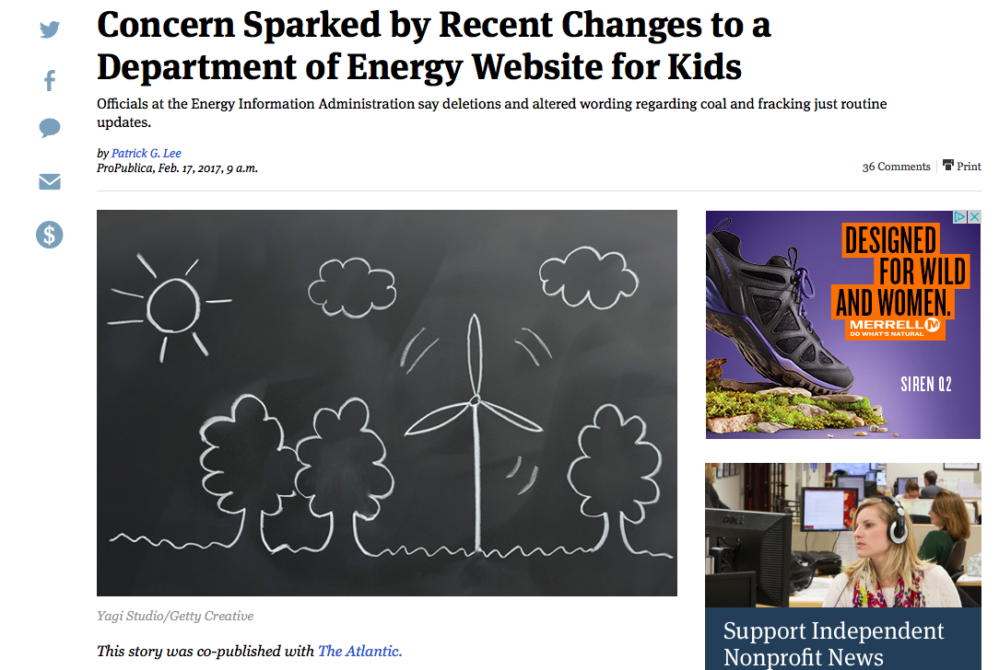
Notes:
https://www.propublica.org/article/childs-play-team-trump-rewrites-a-department-of-energy-website-for-kids

Slide 23
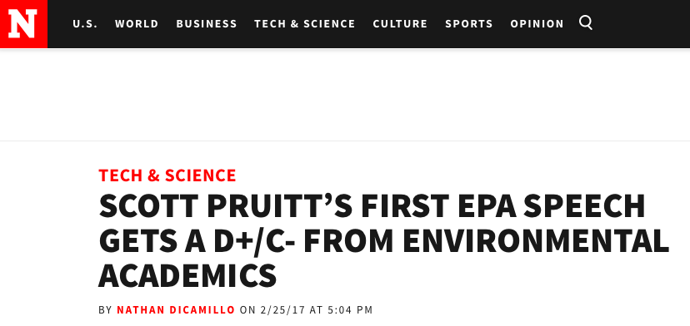
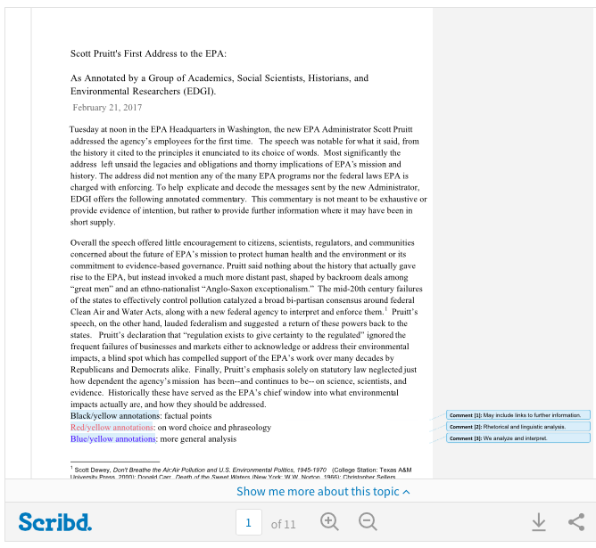

Slide 24

